Slide 1
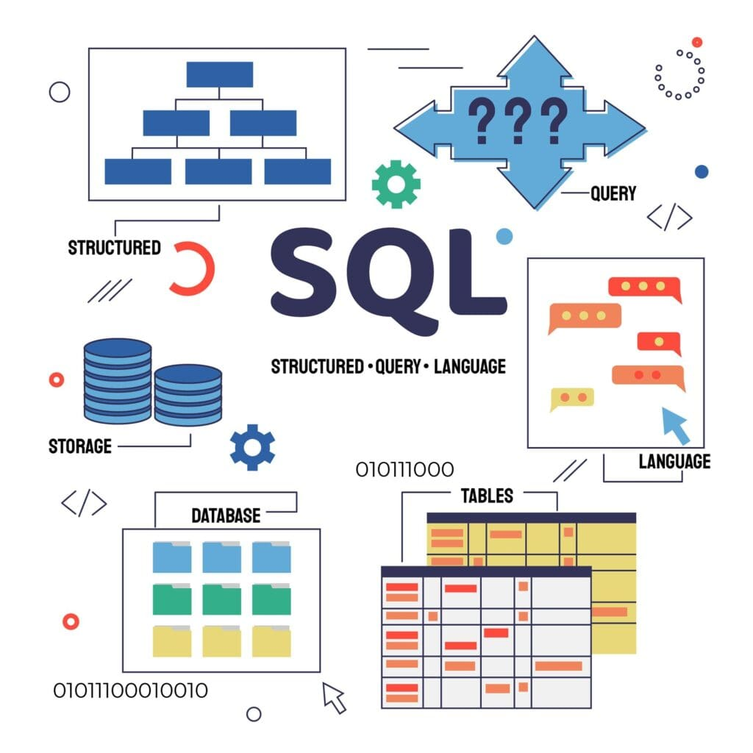



Product sales Project
Presented by: Hlobisile Gwala
gwalahlobisile@gmail.com

Slide 2
Introduction-Project Aims and Procedure
Project overview and business goals
Project aims to determine the most effective selling method between Email, Call and Email + Call.
To perform the analysis the distributions and trends of the revenues for sales method are utilised.
Procedure
Data cleaning performed using python pandas, due to inconsistent naming for the sales methods and revenue column having null values.
To do this, sales method column is modified for consistent naming and null values in the revenue column are filled with 0.
Counter plot was used to count the number of customers approached by each method
Box and whisker plots were utilised to analyse and study the spread of revenue for each approach.
Line plots were used to analyse the weekly revenue trend for each method.
A summary table was included to compare the total revenues generated by each method
gwalahlobisile@gmail.com
1

Slide 3
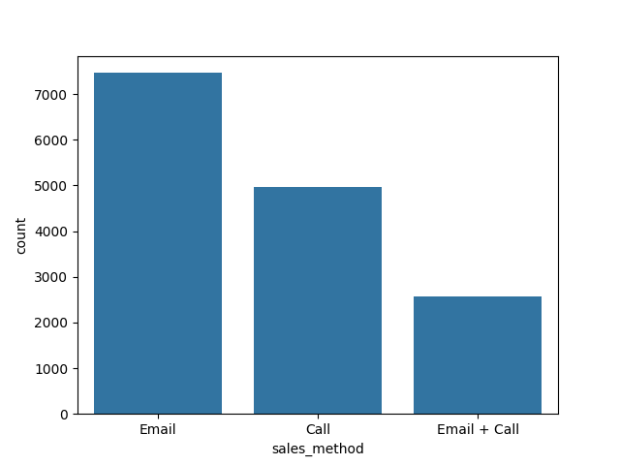
Key findings
A counter plot displaying how many customers were approached by each method.
Looking at the plot, one can conclude that Email method has approached more customers compared to the other methods.
gwalahlobisile@gmail.com
2

Slide 4
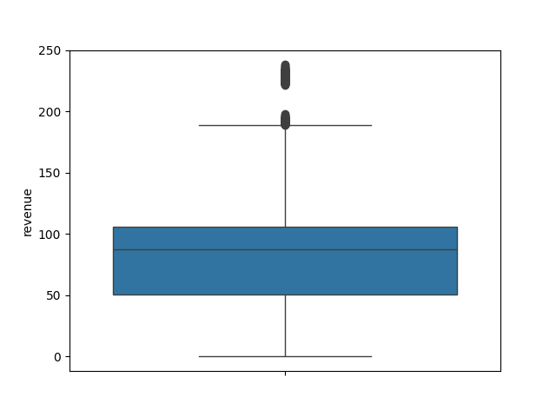
Key findings
A box plot showing the spread of the overall revenue .
Most revenues are concentrated between the 50th and 75th percentile
Fewer revenues are spread out between the 25th and 50th percentile .
Long upper whiskers
gwalahlobisile@gmail.com
3

Slide 5
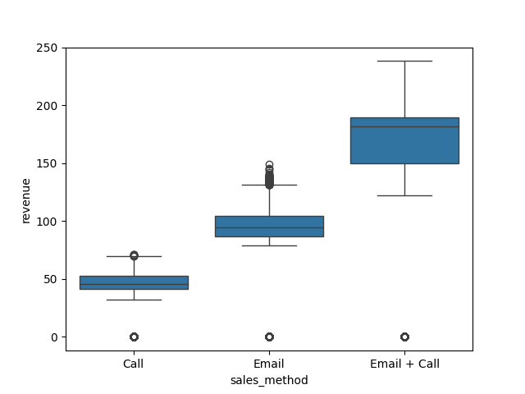

Key findings
This box plot shows the revenue spread for each sales method.
Call method is positively skewed, having most revenues concentrated between 25th and 50th percentile.
Email method is also positively skewed, having most revenues concentrated between 25th and 50th percentile.
Email + Call method is negatively skewed, having most revenues concentrated between 50th and 75th percentile.
gwalahlobisile@gmail.com
4

Slide 6
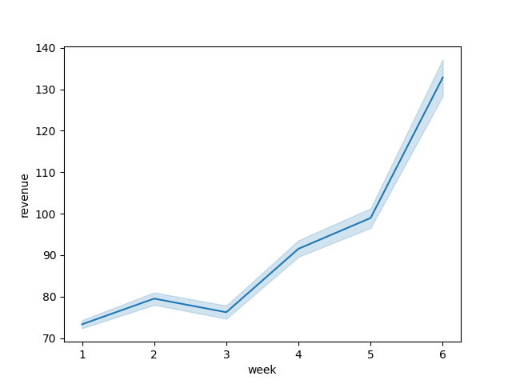
Key findings
This is a line plot that shows the overall trend of average revenue over time.
95% confident interval
Average revenue drop on week 3
gwalahlobisile@gmail.com
5

Slide 7
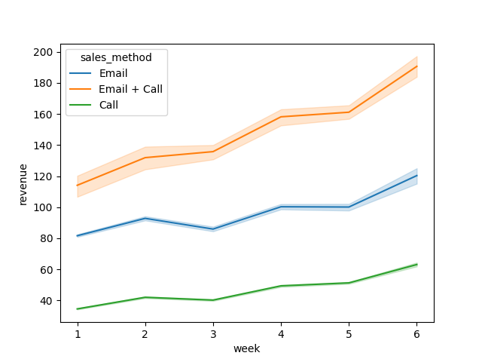
Line plots show the trends of the revenue for each sales method over time.
gwalahlobisile@gmail.com
6

Slide 8
Sales Method | Total Revenue
Call | 227563.49
Email | 672317.83
Email + Call | 408256.69
Email method generated the highest total revenue
Call method generated the lowest total revenue
Email + Call method generated less revenue than Email method, number of customers for each method has impact on these results.
gwalahlobisile@gmail.com
7

Slide 9
Summary
Based on the analysis, the Email + Call method is recommended for its consistent average revenue growth, making it the most effective sales strategy over time. This method allows customers more time to view new products through email, followed by a call a week later, providing an opportunity to ask questions and gain informative use of the products.
Call method is generating less revenues on average, possibly due to customers forgetting product names or not clearly understanding them during the call.
Email method takes less time to approach customers and is effective but does not generate higher revenues on average compared to the Email + Call method.
One might ask why not recommend Email method because it generated the highest total revenue. While the Email method generated the highest total revenue, it is important to note that the sales method approached different number of customers. Therefore, precise analysis recommendation was concluded using spread of the revenue for each sales method and the trend of the revenue overtime for each method.
gwalahlobisile@gmail.com
8

